Slide 1

Mini Project-I (K24MCA18P) Odd Semester Session 2024-25
TaskEaze
Team Leader: Mradul Tyagi - 2426MCA195
Members:
Nainsi Jain - 2426MCA679
Gargi Singh - 2426MCA660
Project Supervisor:
Mr. Arpit Dogra
Assistant Professor

Slide 2

TaskEaze: A Comprehensive Task Management Application
TaskEaze is a task management application designed to streamline workflows and enhance productivity. It offers a user-friendly platform leveraging the latest technology.

Slide 3

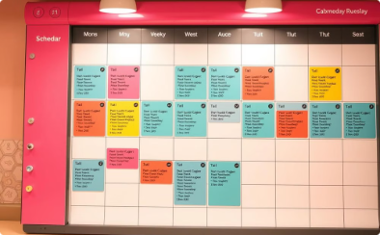
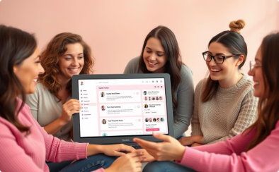
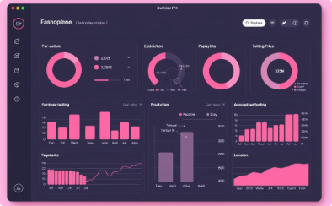
The Evolution of Task Management
Simple To-Do Lists
Task Categorization and Scheduling
Collaborative Features and Gamification
Advanced Reporting and Analytics
Basic organization and tracking.
Improved organization and time management.
Enhanced teamwork and engagement.
Data-driven insights for optimization.

Slide 4

Project Objective
1
Streamlined Task Management
2
Prioritization & Progress Tracking
Efficiently manage daily routines and projects
Prioritize tasks and monitor progress
3
Collaborative Features
Share tasks and work efficiently on team projects

Slide 5
Technology Stack & Requirements
Frontend
Backend
Platform used
HTML, CSS, JavaScript, Bootstrap
MySQL , Node js, Express js
VS Code

Slide 6

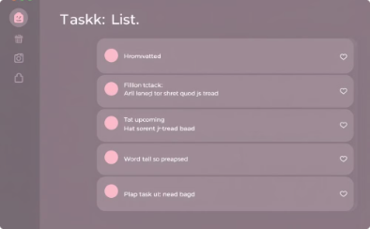
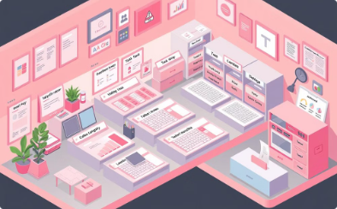
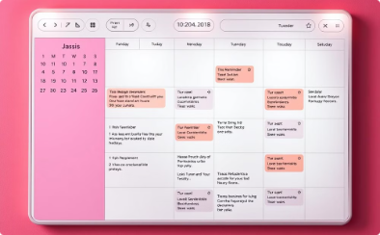
Application Modules
User Authentication
Task Management
Task Categorization
Scheduling
Registration, login, profile management
Create, edit, delete tasks, receive notifications
Organize tasks, add notes
Advanced scheduling, calendar integration

Slide 7
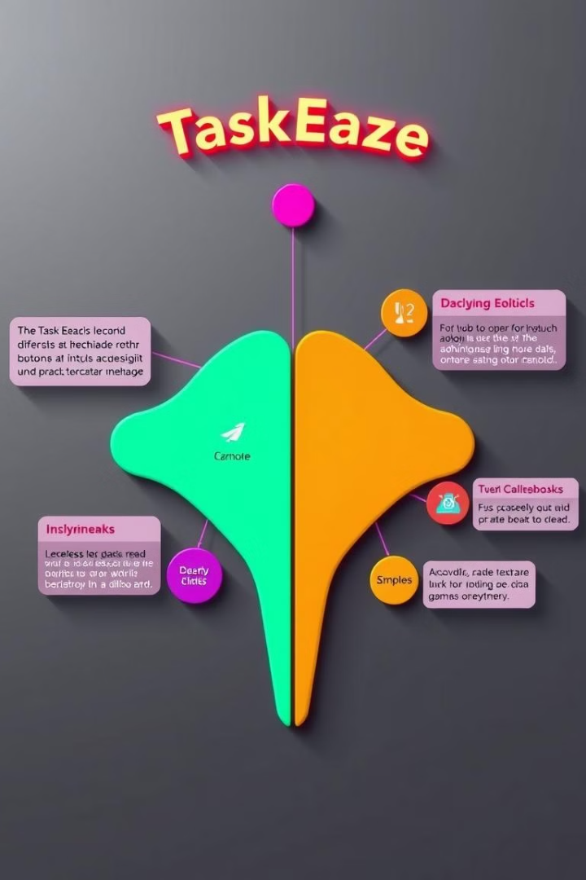
Modules (Contd.)
Progress Tracking
Routine Sharing
Weekly & monthly progress reports
Share routines on social platforms
Customization
Gamification
Theme selection, dark mode
Achievements, badges

Slide 8
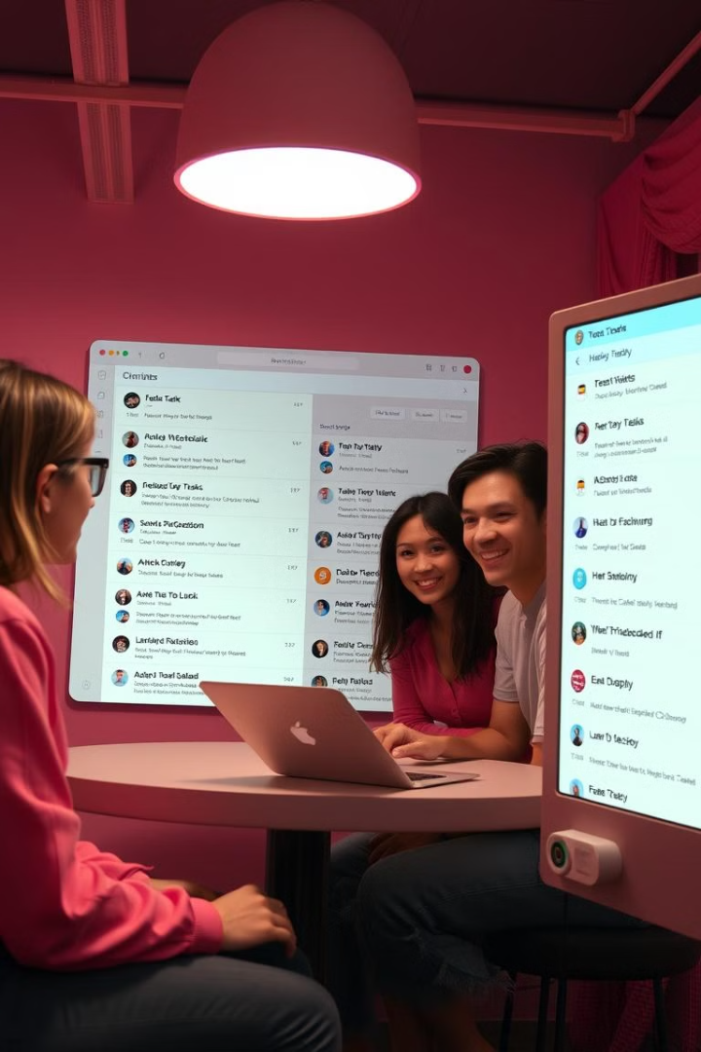



Collaboration
Task Sharing
Collaborate on group projects
Shared Calendar
Manage deadlines and events together
Real-Time Communication
Discuss tasks and share updates

Slide 9




Workflow
Task Creation
Create and define tasks
Categorization & Scheduling
Organize tasks into categories and schedule them
Progress Tracking & Reporting
Monitor progress and generate reports

Slide 10





Impact & Future Directions
1
Increased Productivity
Improved Time Management
2
Reduced stress and anxiety
Enhanced Collaboration
3
Improved teamwork and communication
Data-Driven Insights
4
Informed decision-making
Continuous Improvement
5
Ongoing development and innovation

Slide 11
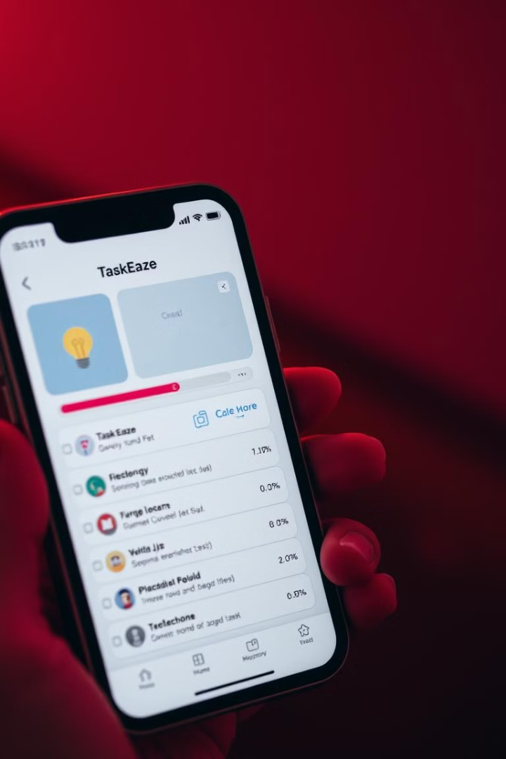
Key Takeaways
1
Comprehensive Task Management
2
Modern Technology
Utilizes web technologies for cross-platform compatibility
A user-friendly platform for organizing and managing tasks
3
Future Potential
Continuously evolving to meet user needs

Slide 12
THANK YOU!

